Slide 1
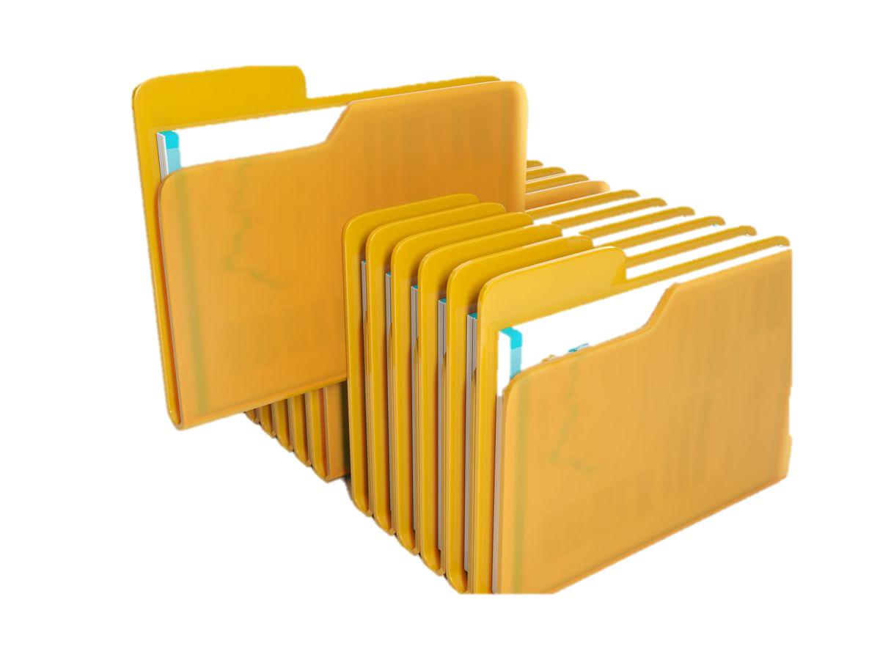
File management
Presentation by – nishchal acharya

Slide 2
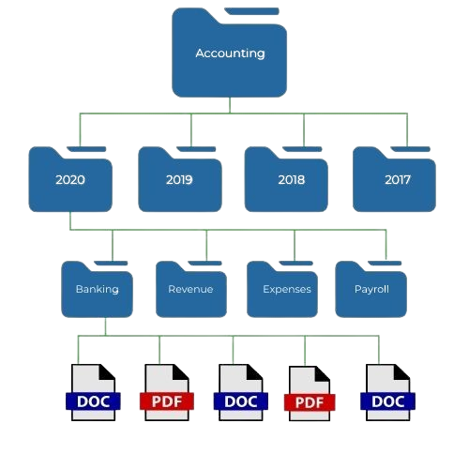
file management
File management is the process of organizing and storing information
in an easily retrievable manner. It involves creating an organized
structure for file storage and using computer storage devices, such as
drives, to hold information. By implementing an effective file management
software, businesses can reduce clutter, improve organization, and enhance
productivity . The purpose of file management is to organize, store, and
access electronic files efficiently and effectively . Good file management
practices enable users to easily locate and retrieve the desired files, ensure
data security, and optimize the use of storage space . The main components
of file management in operating system include organizing files into folders,
storing files on a device or storage system, retrieving stored files from storage
systems when they are needed, and providing an interface for users to access
their files .

Slide 3

Advantages
Certainly! File management plays a crucial role in maintaining an organized and efficient work environment. Let’s explore its benefits:
Modify file
Delete file
Create file
Backup and Risk Reduction
In summary, effective file management contributes to streamlined processes, cost reduction, and improved productivity. Whether digital or physical, maintaining organized files is essential for any business.

Slide 4

Disadvantages
Certainly! Let’s delve into the disadvantages of file management systems
Data Redundancy
Data Inconsistency
Limited Accessibility
Limited Accessibility
Isolated Data
In summary, while file management systems served their purpose in the past, they lack the flexibility, consistency, and efficiency provided by modern database management systems (DBMS).

Slide 5
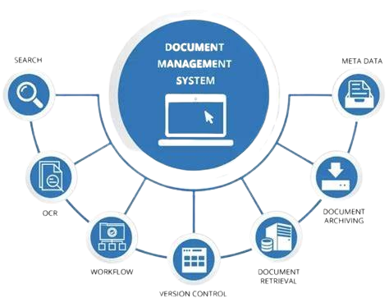
Features
Certainly! Let’s explore the features of file management
Arranging Files and Folders Hierarchically
File Operations
Assigning Documents for Processing in a Queue
Metadata Management
User-Friendly Interface
File management involves organizing, tracking, and manipulating digital files efficiently. Key features include hierarchical arrangement, reporting, notes, status tracking, metadata management, user-friendly interfaces, and essential file operations.

Slide 6

File Extension
A file extension is a suffix at the end of a computer file that identifies what application opens it. In Windows, file names consist of two parts separated by a period: the file name and a three- or four-character extension that defines the file type. For instance, in the file name “expenses.xlsx,” “expenses” is the first part, and “xlsx” is the extension.
.docx: Microsoft Word document
.pdf: Portable Document Format file
.mp4: MPEG-4 video
.jpg or .jpeg: Joint Photographic Experts Group photo file
.xlsx: Microsoft Excel spreadsheet
.html or .htm: Hypertext markup language page
.exe: Executable program file

Slide 7
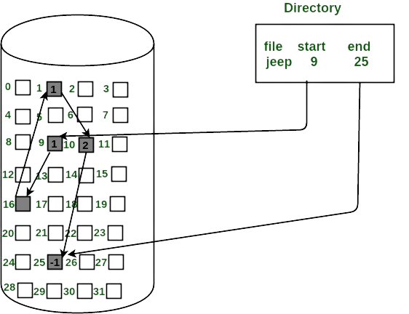
File allocation
File allocation methods are different ways by which the operating system stores information in memory blocks. There are 5 types of file allocation methods in OS. Contiguous File allocation, Linked File Allocation, Indexed File Allocation, File Allocation Table (FAT), and Inode.
In the example shown, there is a file named count which starts from disk block number 0 and the length of the file is 2 blocks. That is, disk block number 0 and disk block number 1 are allocated for the file. Similarly, the file named mail starts from disk block number 19 and the length is 6 disk blocks.

Slide 8
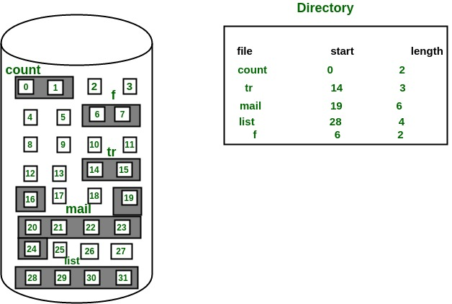
Contiguous Allocation
In this scheme, each file occupies a contiguous set of blocks on the disk. For example, if a file requires n blocks and is given a block b as the starting location, then the blocks assigned to the file will be: b, b+1, b+2,……b+n-1. This means that given the starting block address and the length of the file (in terms of blocks required), we can determine the blocks occupied by the file.

Slide 9
Linked allocation
In this scheme, each file is a linked list of disk blocks which need not be contiguous. The disk blocks can be scattered anywhere on the disk. The directory entry contains a pointer to the starting and the ending file block. Each block contains a pointer to the next block occupied by the file.

Slide 10
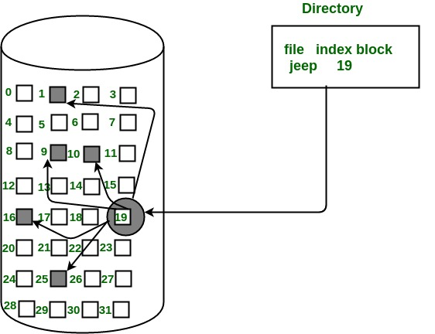
Indexed allocation
In this scheme, a special block known as the Index block contains the pointers to all the blocks occupied by a file. Each file has its own index block. The ith entry in the index block contains the disk address of the ith file block. The directory entry contains the address of the index block as shown in the image:

Slide 11

Thankyou soooooo much
“Thank you to my classmate for actively listening to my presentation, and heartfelt thanks to Jitendra Sir for providing me with this valuable opportunity.” 😊

